Slide 1
Laptop Setup
How to set up FLL laptops for VS Code, Python, Pybricks and Git/github

Slide 2
Step 1. Install software
VS Code https://code.visualstudio.com/ Editing python programs. Use the "System Installer".
Python 3 https://www.python.org/ It's python. Install in c:\python\ (use the "custom installation" option)
git for Windows https://git-scm.com/downloads Be sure to select VS code as your default editor.
pybricks https://pybricks.com/ https://code.pybricks.com/ and https://beta.pybricks.com/ Nothing to install on your computer, but you will need to install it on your robot.

Slide 3
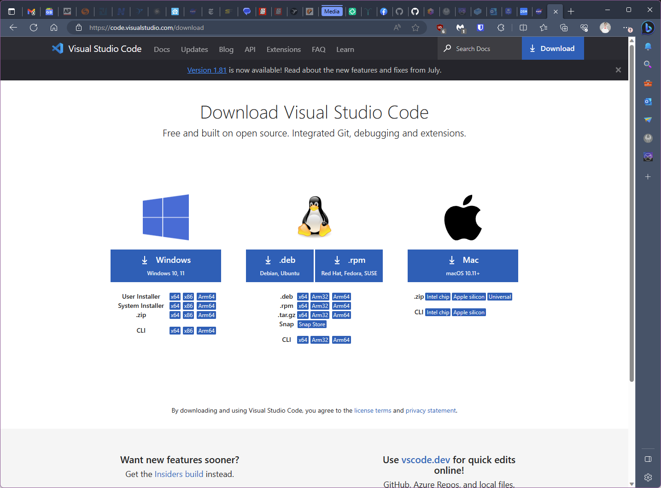
Install VS Code
Use the Windows System x64 installer. Will require the admin password

Slide 4
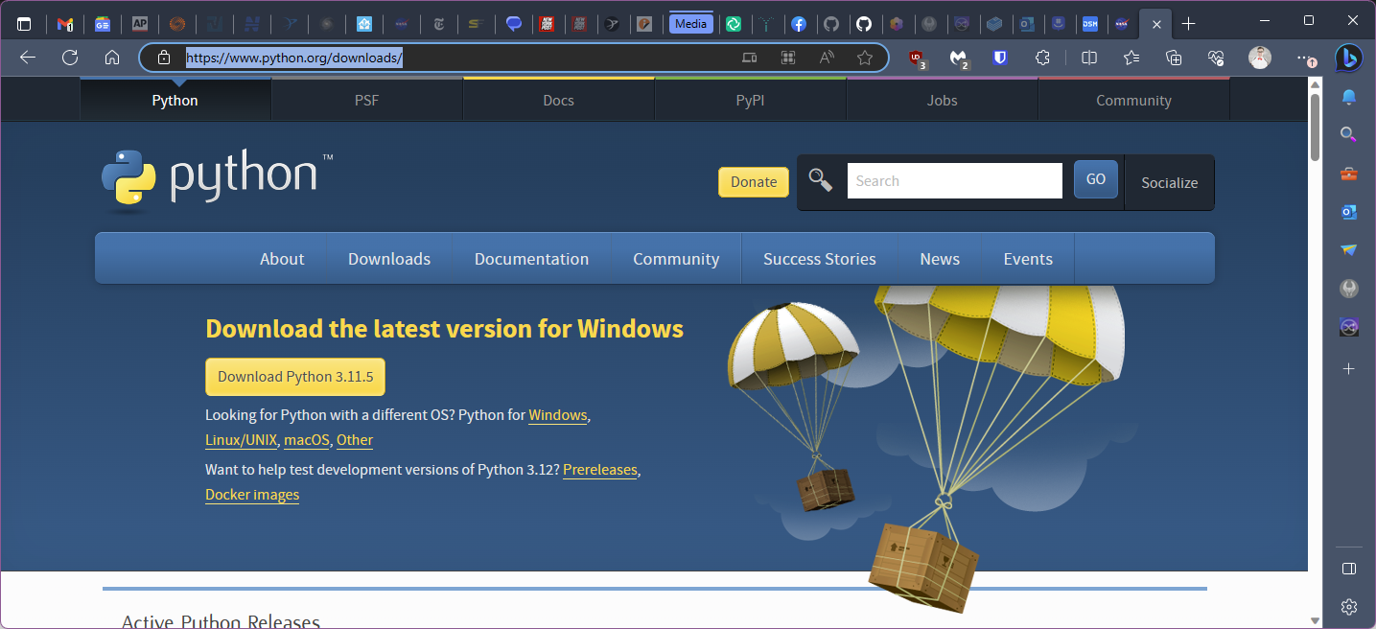
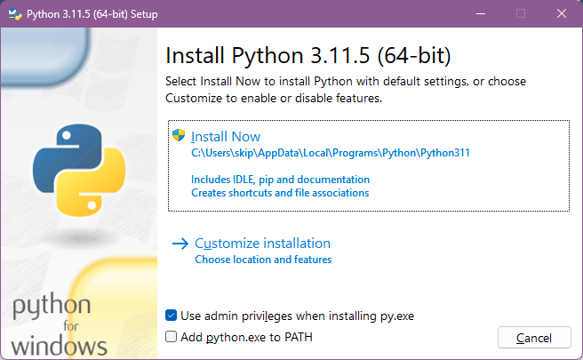
Install Python 3
Choose Customize Installation. Also, check the box at the bottom to add python.exe to PATH

Slide 5
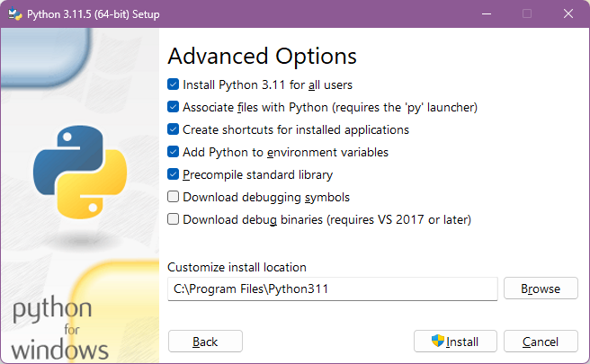
Be sure to check these options

Slide 6
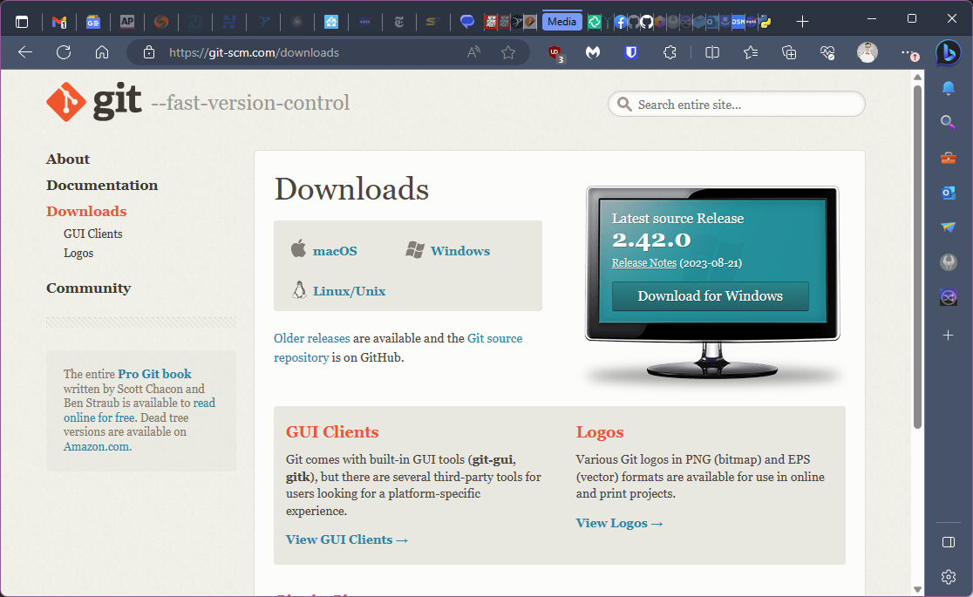
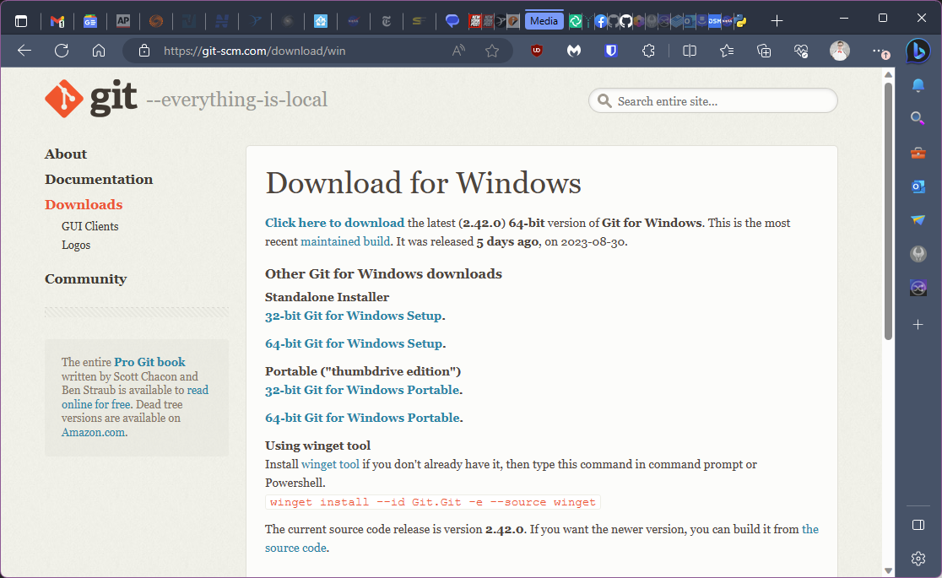
Git installation
Download the latest 64 bit version for windows.

Slide 7
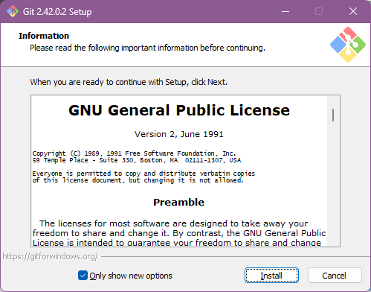
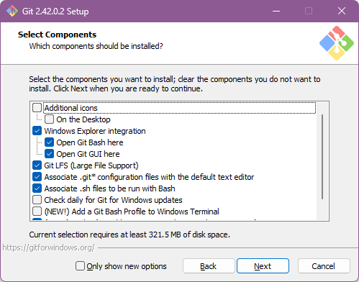
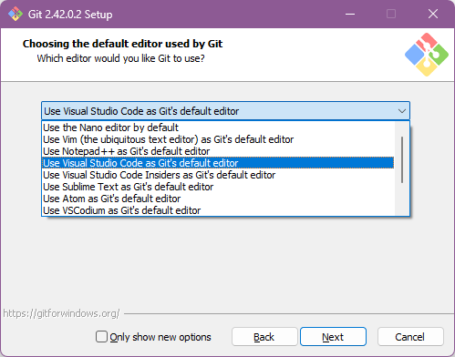
Be sure to use VS Code as the default editor
Click Next, then click “Next” nine more times. Then install.

Slide 8
Step 2. Create github account
http://github.com
You will need a phone or yubi key to set up 2FA
Do NOT forget your username and password.

Slide 9
Step 3. Invite each member as a collaborator
One of the coaches will invite you to be a collaborator on the team repository
Tell the coach your username so they can invite you

Slide 10
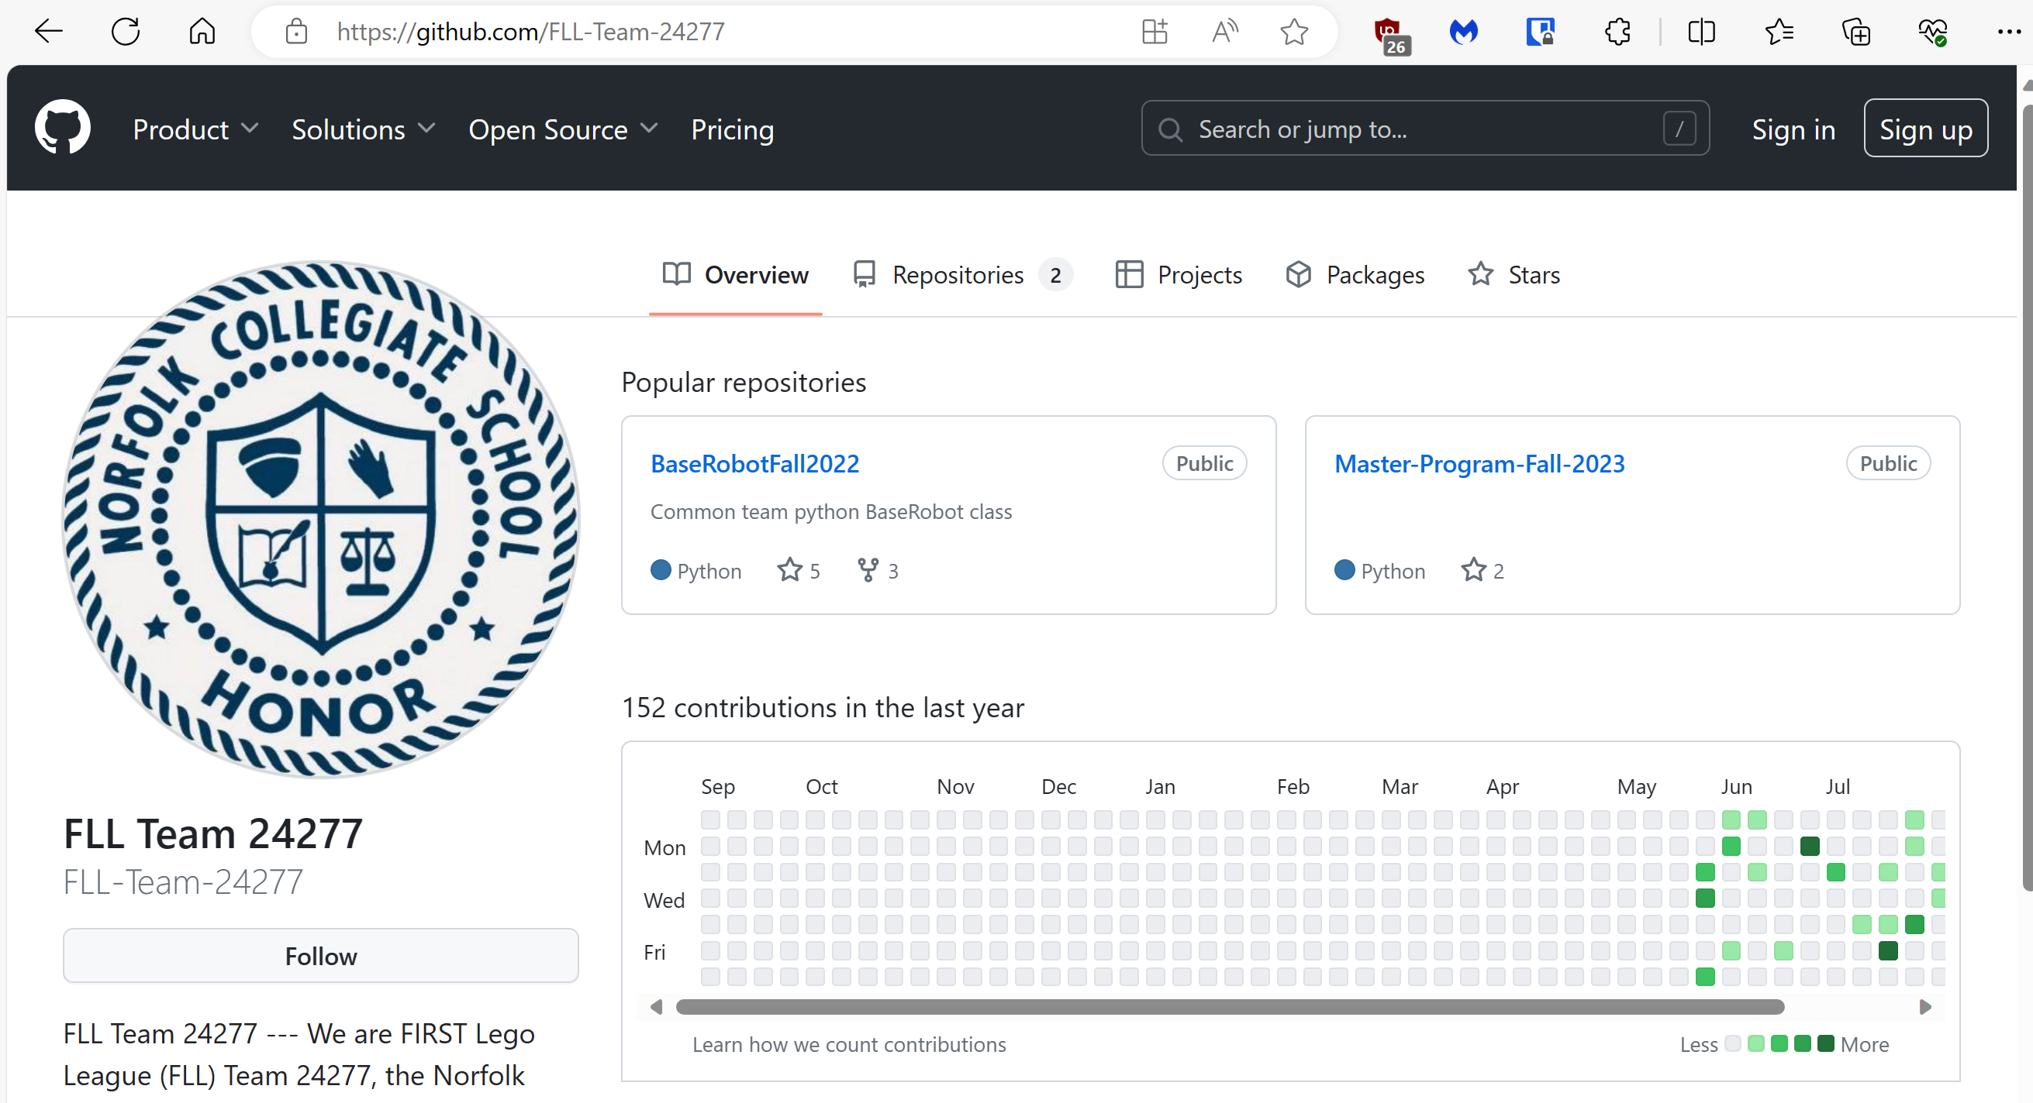
Step 4. Accept invitation
Look at your github notifications. Click “accept”
Go to the team github repo
Click on Master-Program-Fall-2023
https://github.com/FLL-Team-24277

Slide 11
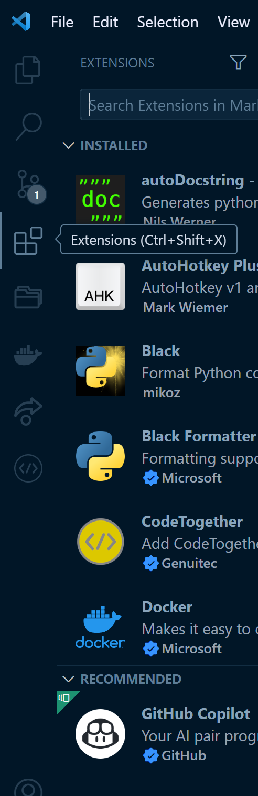
Step 5. VS Code Extensions
Open VS Code and install the following extensions
Error Lens
Git-autoconfig
GitHub Pull Requests and Issues
Python
Pylance
Black
Black Formatter
PDF Viewer
Restart VS Code
Clone the Team’s Repository and open the project
Get the link from the Team github repository

Slide 12
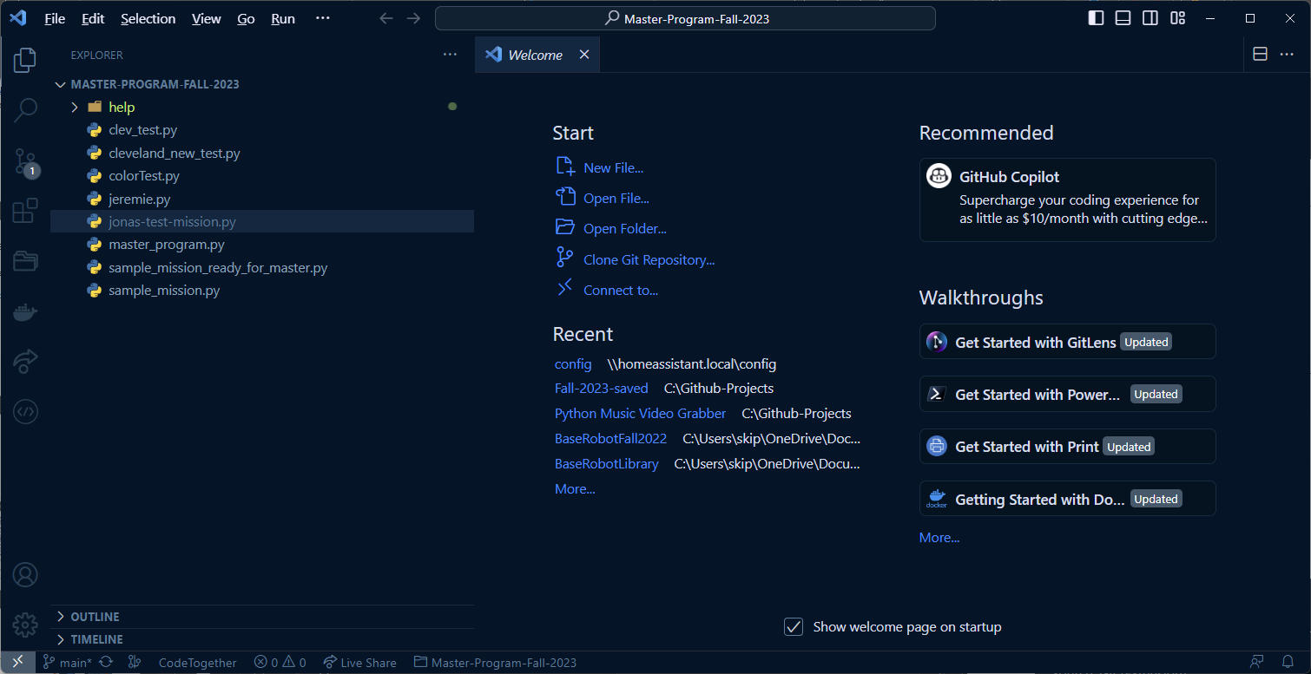
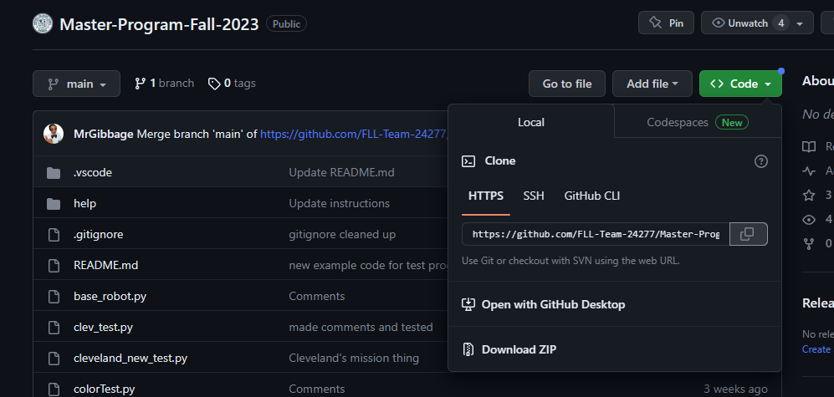

Slide 13
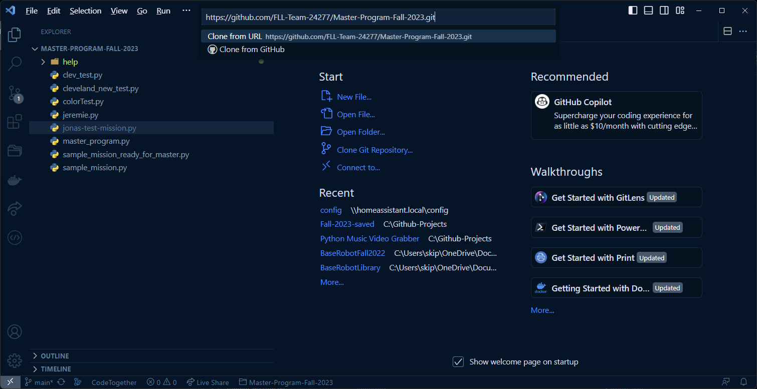

Slide 14
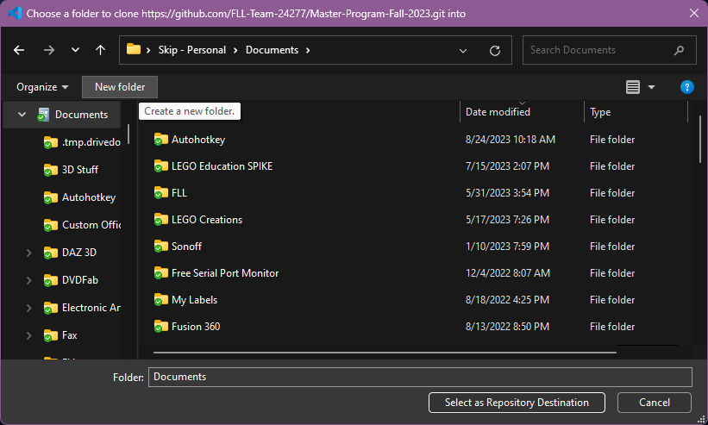
Create a new folder in your Documents and name it “FLL”.
Go into that folder and Select as Repository Destination

Slide 15
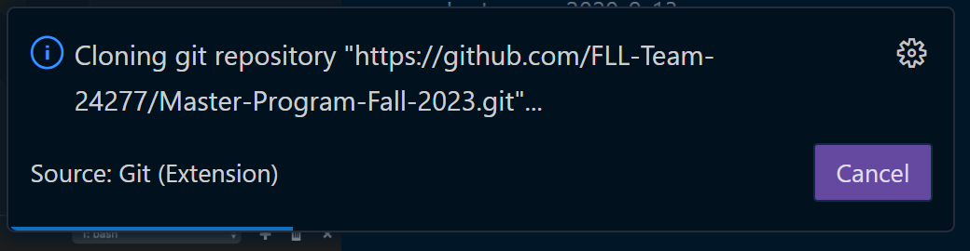
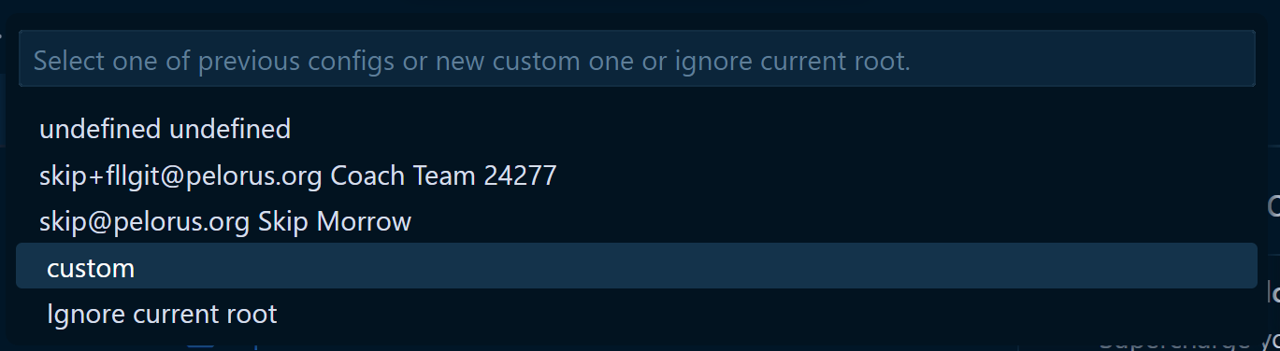

Slide 16
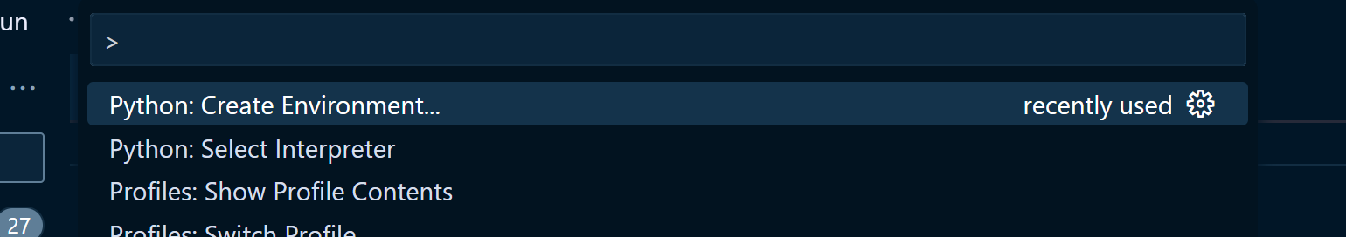
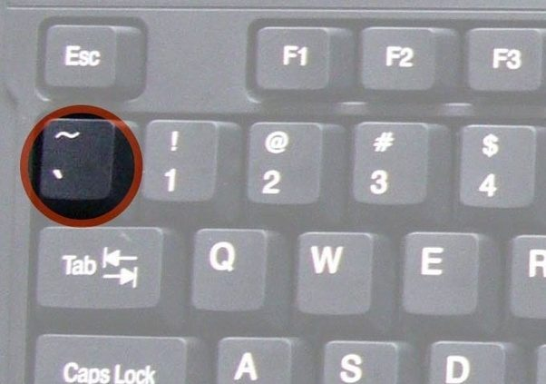
Step 6. Add Python Virtual Environment
Add a python virtual environment.
Ctrl-Shift-P > Python: Create Environment. Just use the defaults.
Pro-tip: Try typing Ctrl-Shift-P, then “cre env”
Open PowerShell
Set-ExecutionPolicy RemoteSigned
Pro-tip: Just type “set-ex” and then hit Tab, then type “re” and then hit Tab
Will need admin password
Restart VS Code
Open a new terminal with ctrl-shift-` or Ctrl-Shift-P > Create Terminal and make sure it is in the python virtual environment. It will start with a green "(.venv)".

Slide 17
Step 7. Python and Git Requirements
pip install -r .\requirements.txt
Pro-tip: type “pip install req” then hit Tab
If you entered your name and email address earlier, then you won’t need to do these next two steps
git config --global user.name “YourName“
Pro-tip: After running the user.name command, hit the cursor up-arrow, then edit the command to run the next command below
git config --global user.email “yourEmail@example.com"

Slide 18
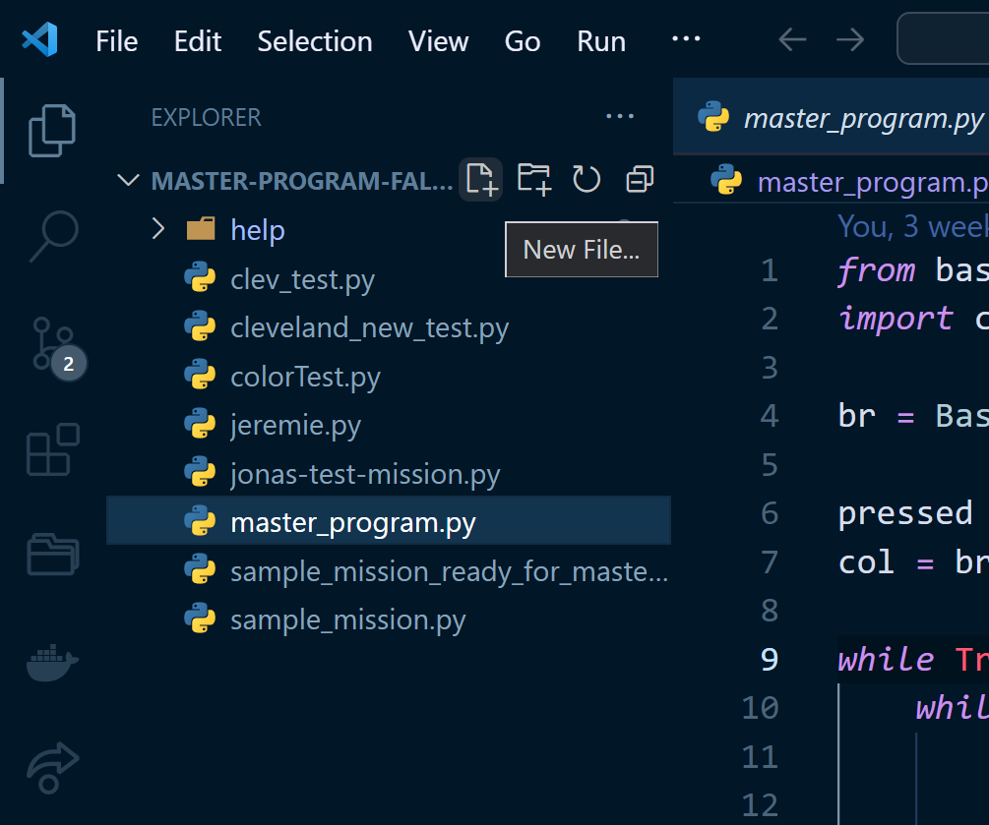
Step 8. Create Test File
Create a new python file, named teamMemberName-test-mission.py. Keep it all lowercase and no spaces. It MUST end with “.py”
Copy and paste the code from the team github page, and save it
Note that after saving the file, the python Black Formatter should correct the intentional "incorrect" spacing around the equals signs and commas.

Slide 19
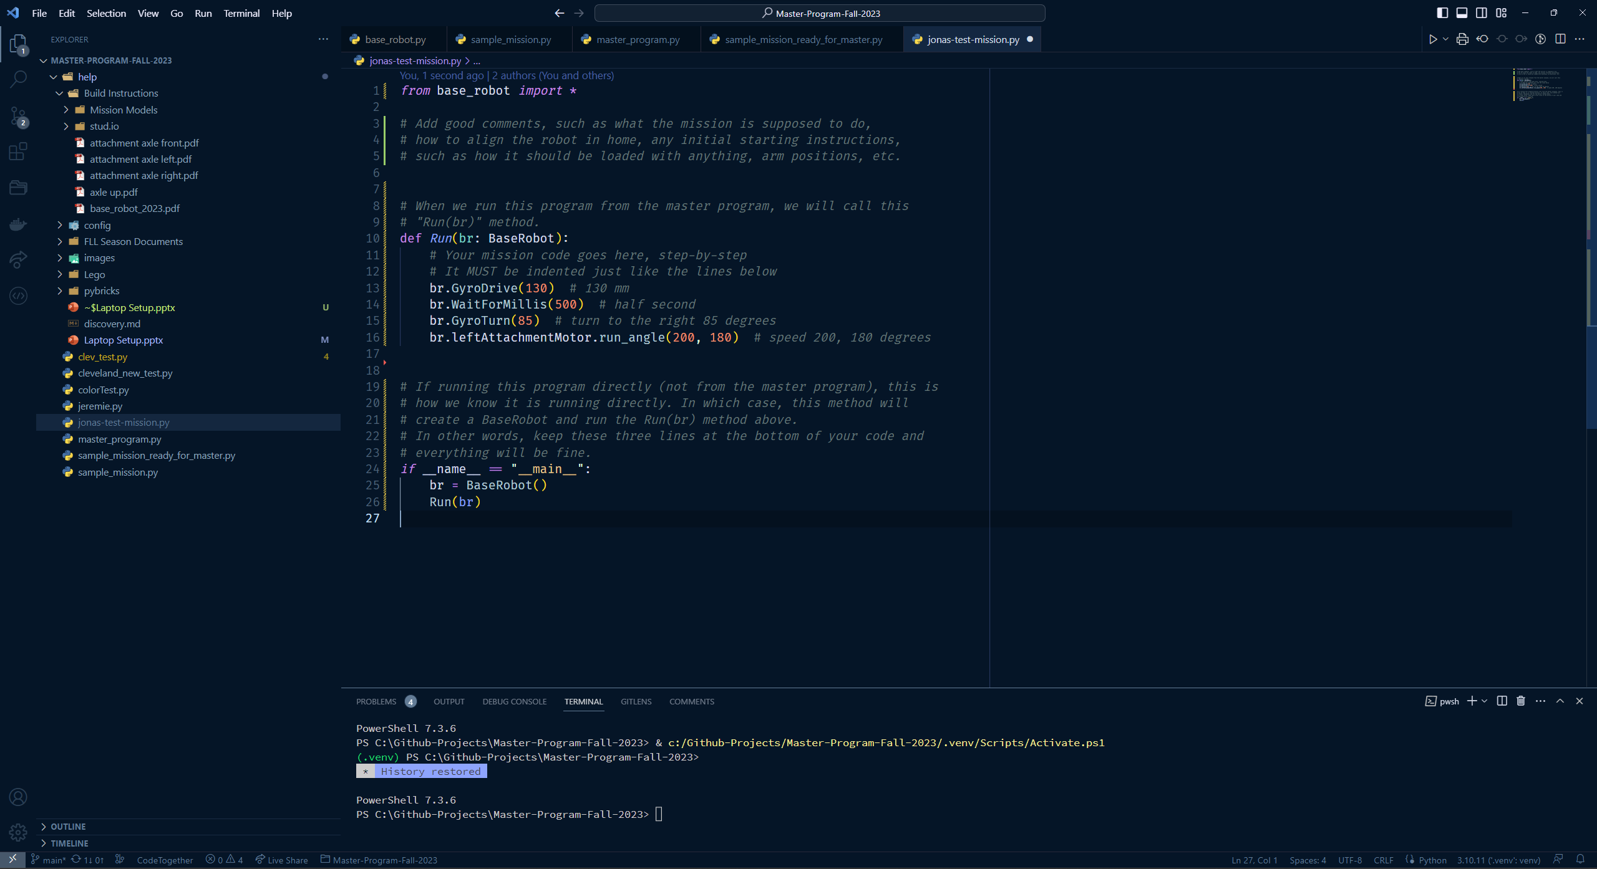

Slide 20
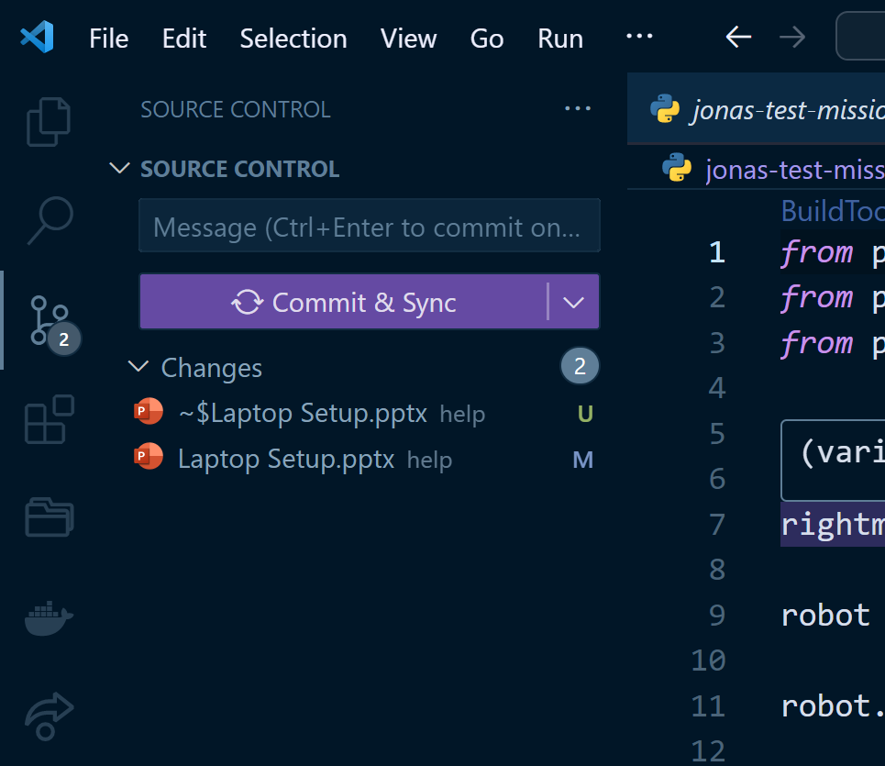
Step 9. Commit Changes
Press Ctrl-S to save your test program
Commit the changes, and push. It will probably prompt for github registration/login and then sync all files.
Just follow the prompts back to the github webpage that we left open
2
3
1

Slide 21
Step 10. Install Pybricks
Install pybricks on each robot at https://beta.pybricks.com/
If the computer has never connected to a pybricks hub, you will probably need to manually install the USB drivers
Name the robot at this time
Avoid spaces and special characters in the robot name
Put a label sticker on the top of the robot with the robot name.

Slide 22
Put hub in “Update Mode”
Preparation:
Disconnect the USB cable.
Make sure the hub is turned off.
Enter update mode (see video):
Press and hold the Bluetooth button on the hub.
Connect the USB cable.
Wait for the Bluetooth light to start blinking pink-green-blue-off.
Release the Bluetooth button.

Slide 23
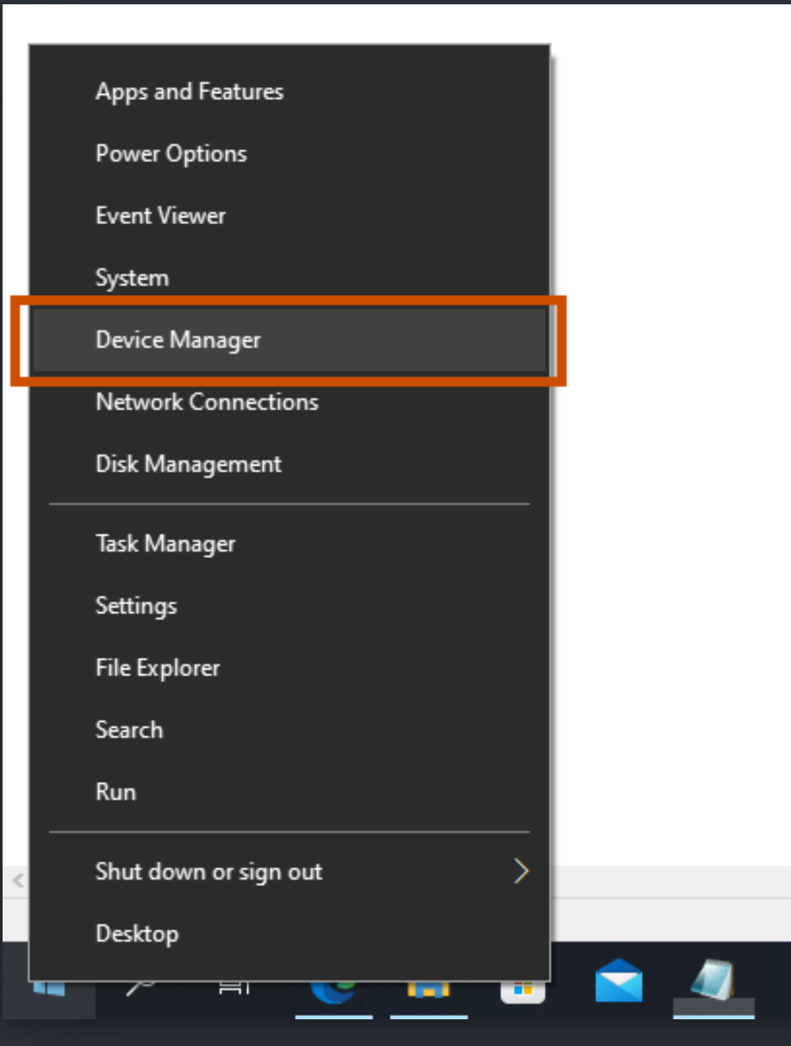
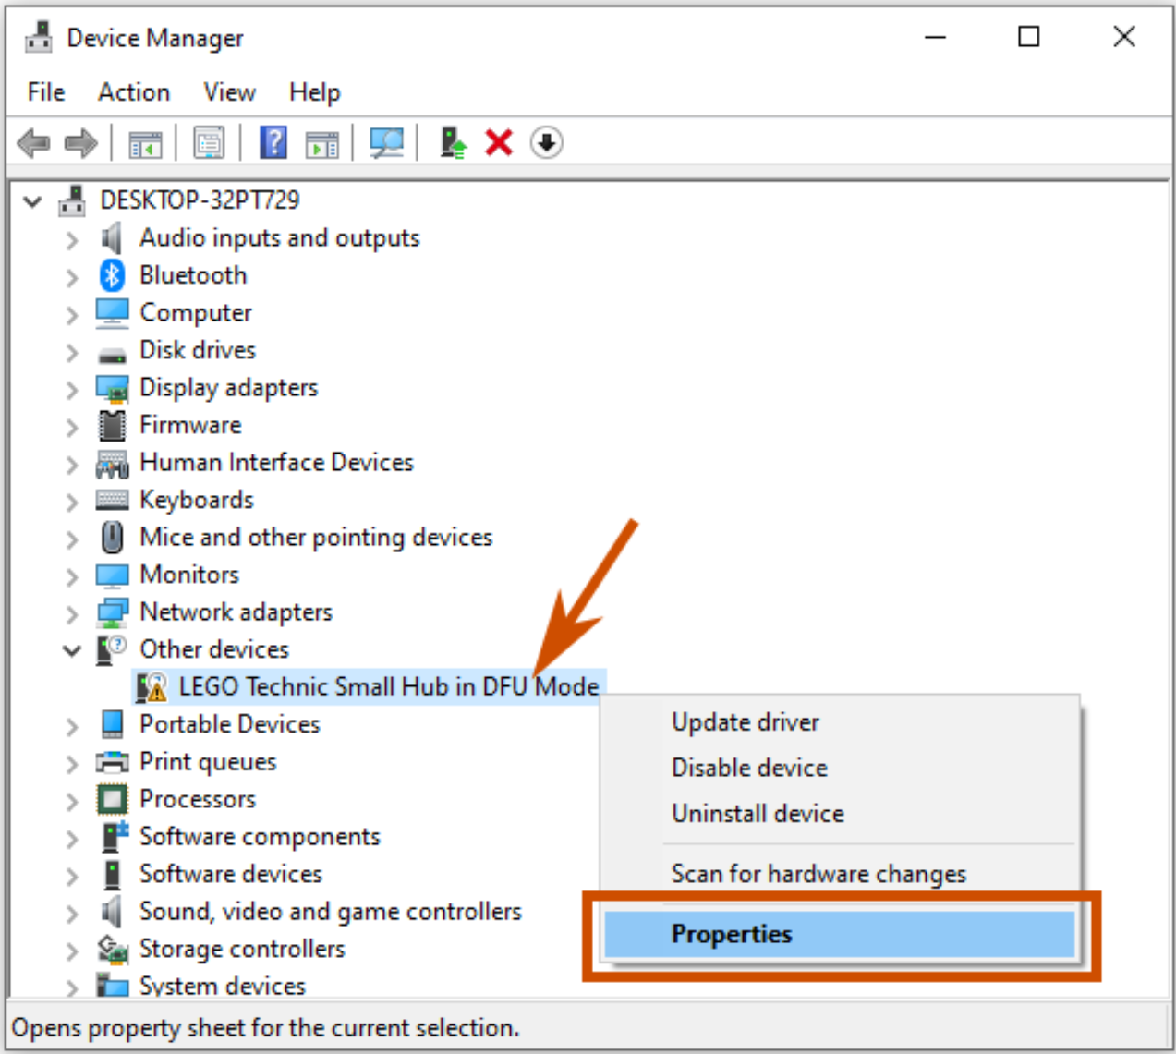
Click on the start menu, then type “dev”

Slide 24
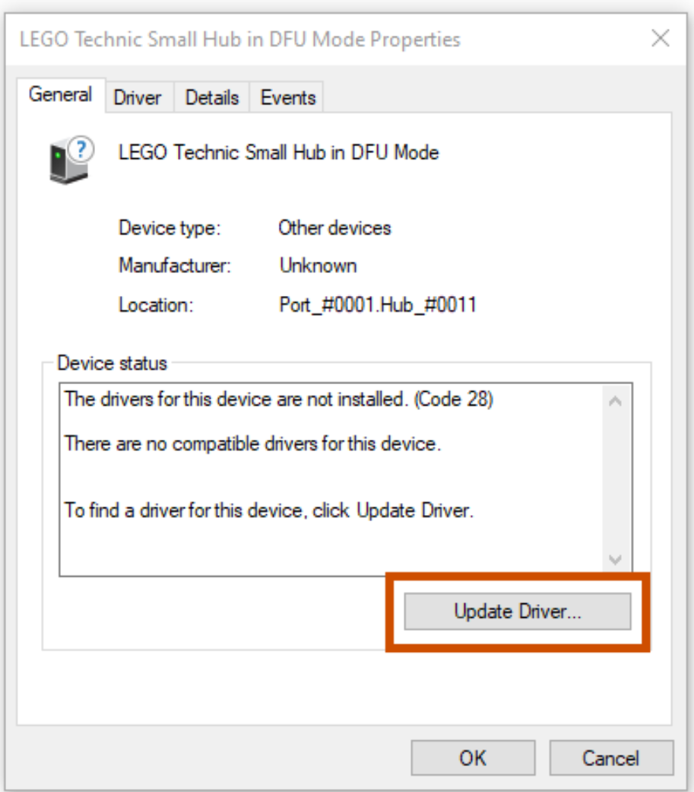
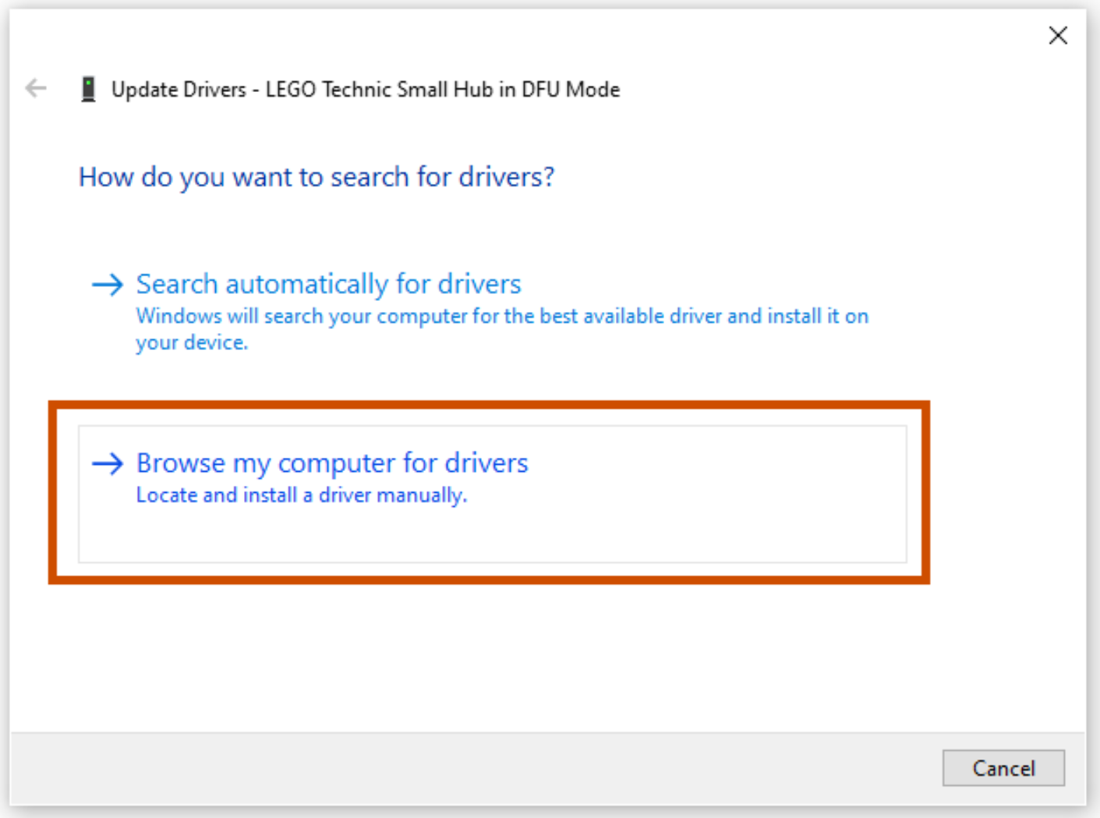
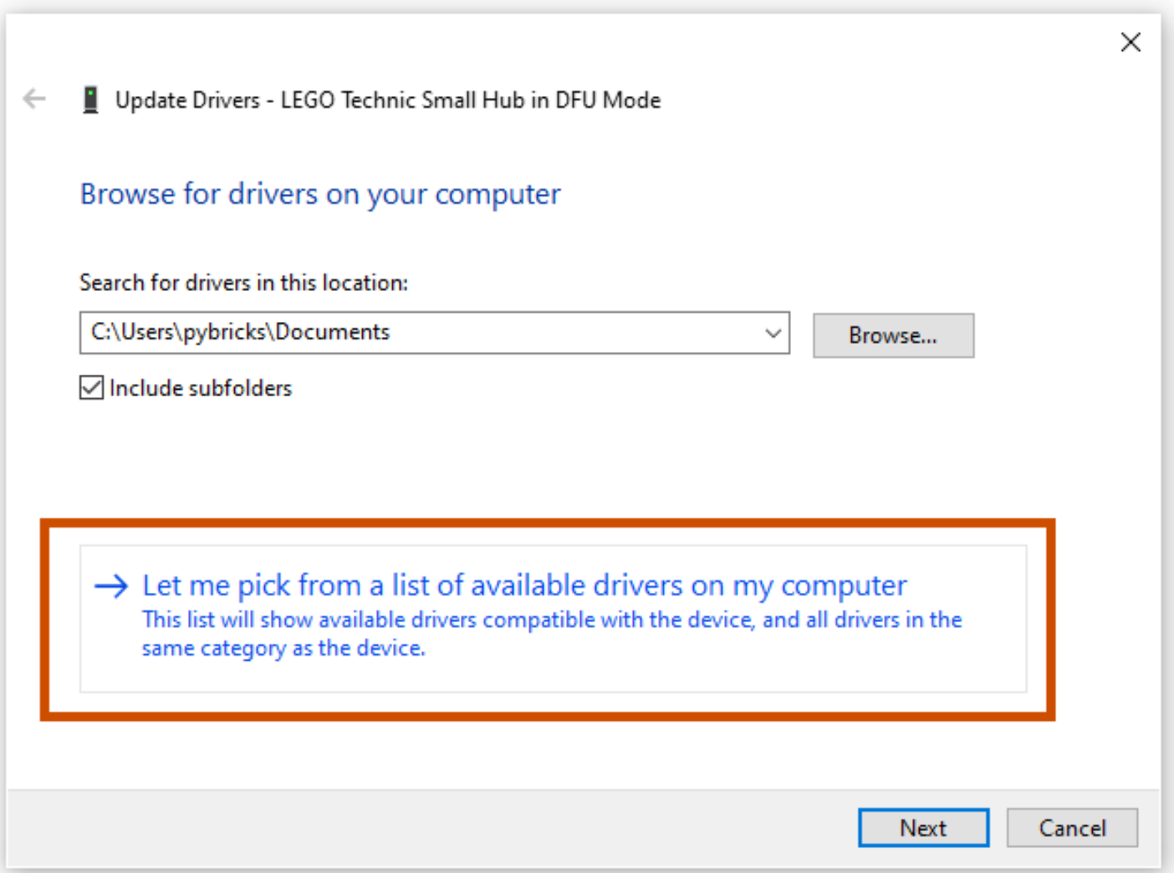
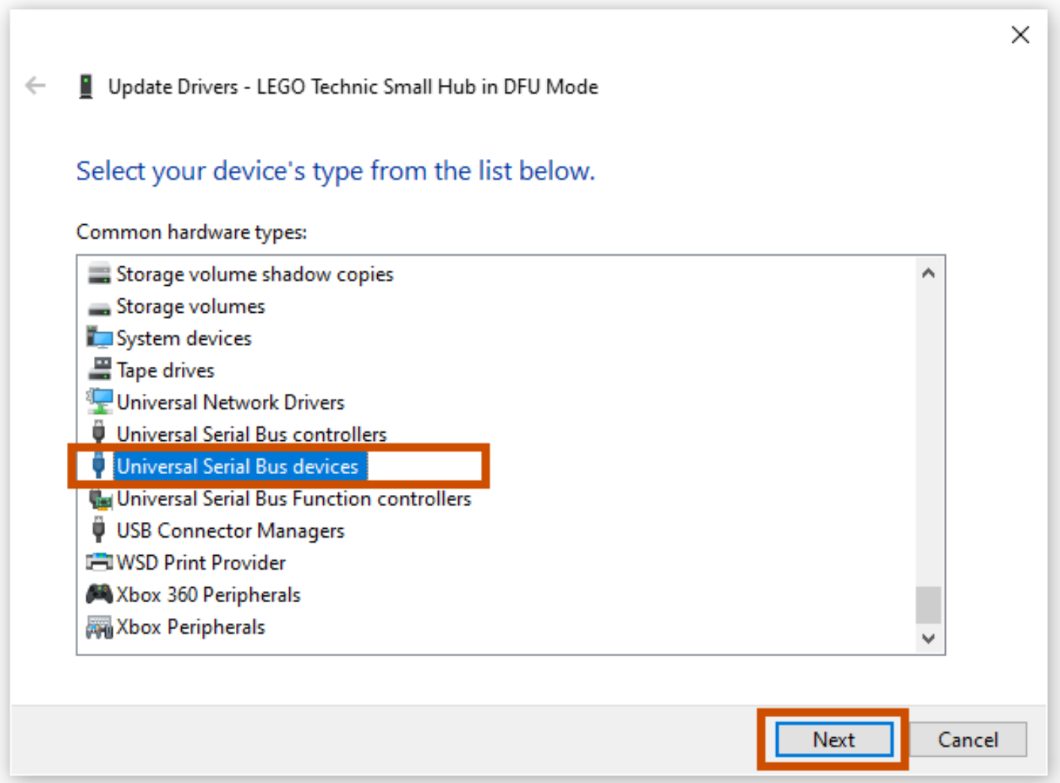
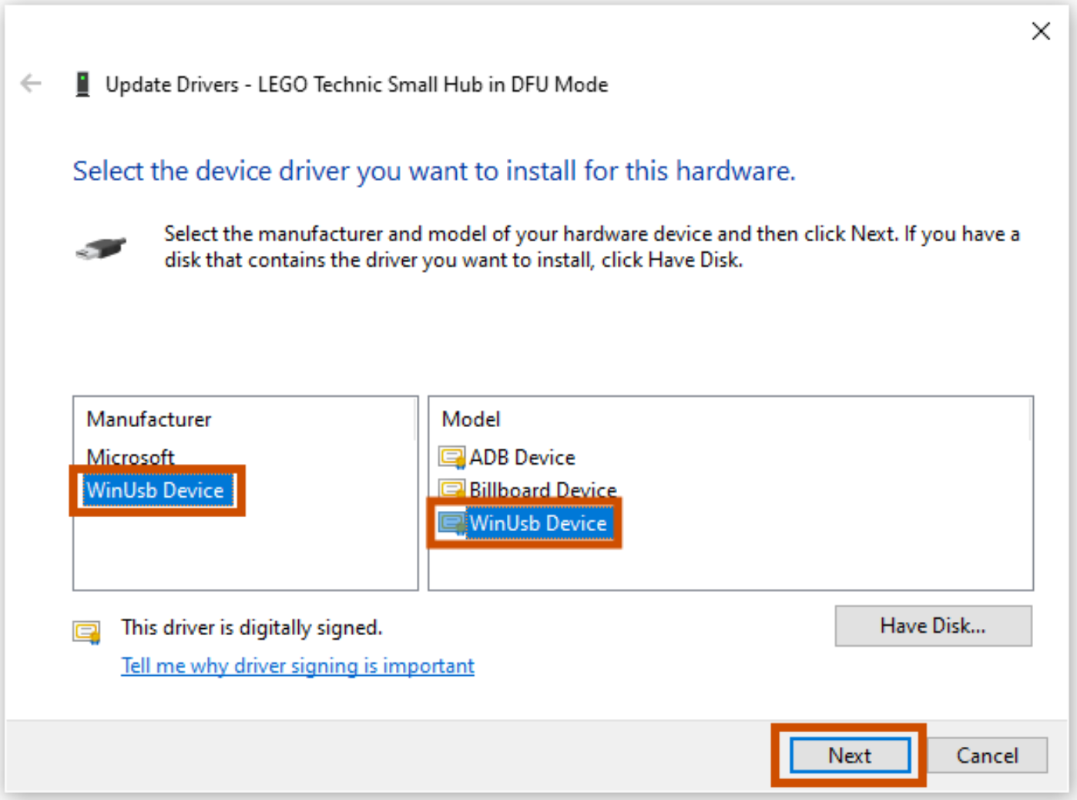

Slide 25
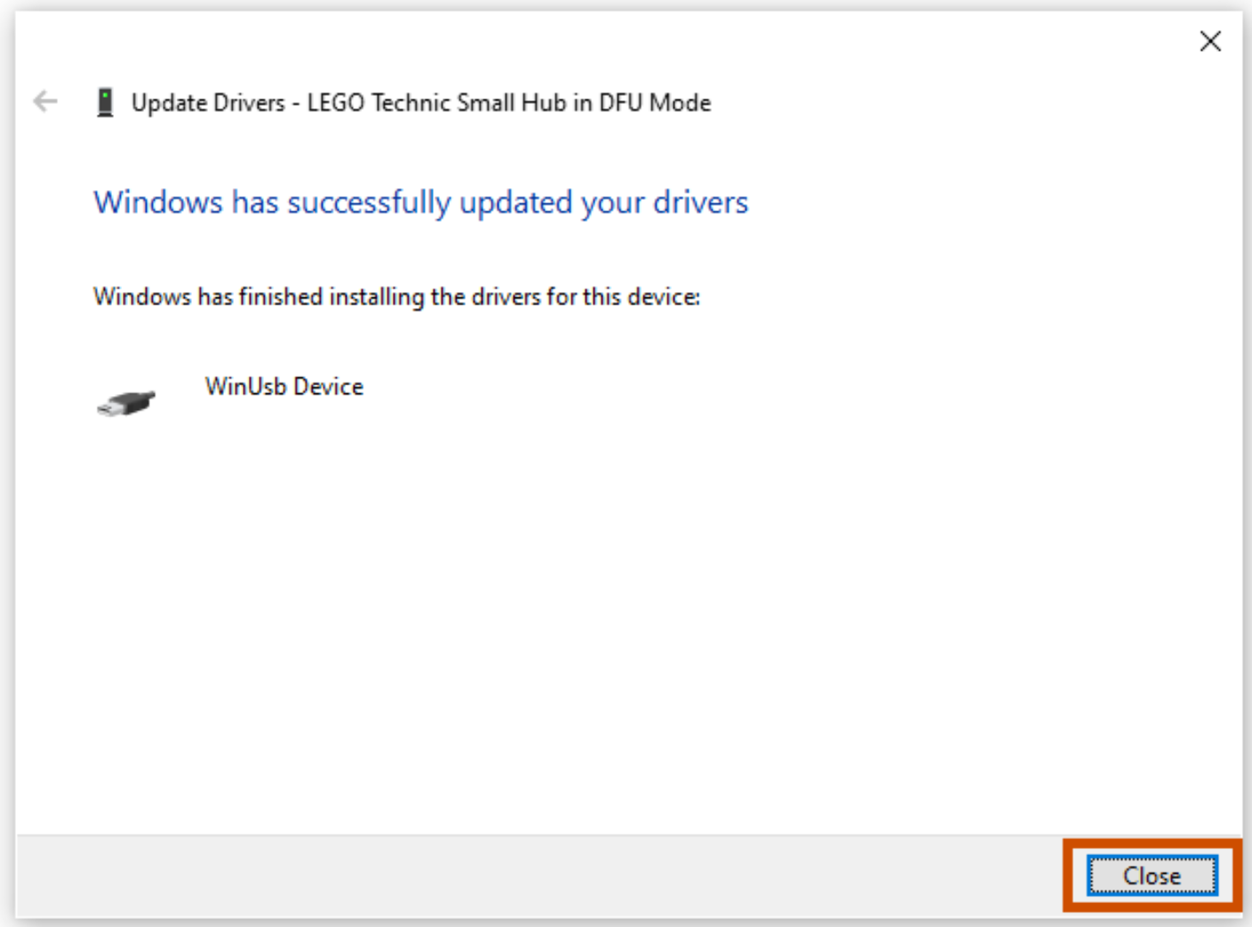
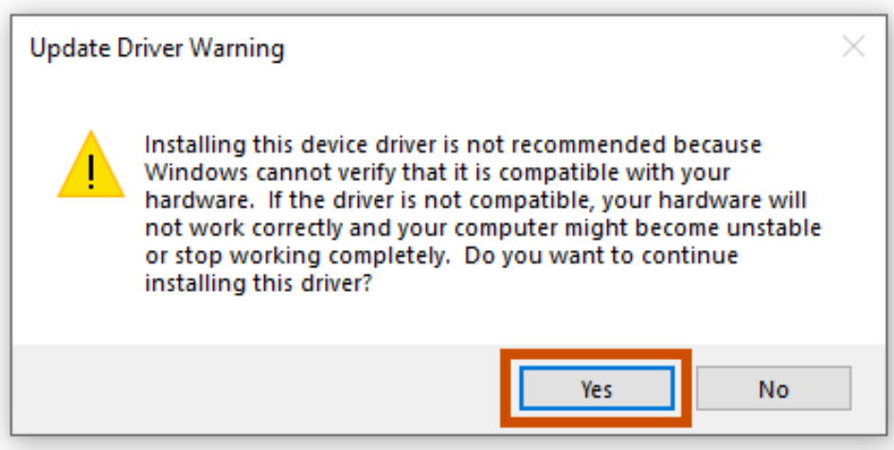

Slide 26
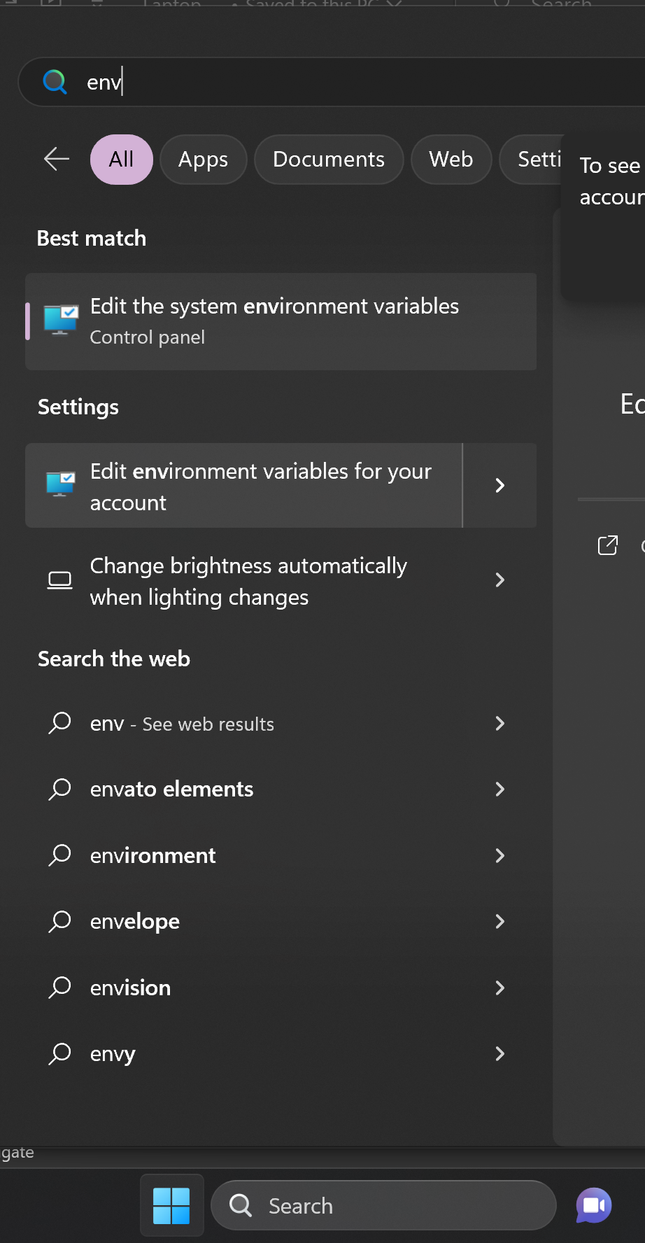
Step 11. User Environment Variables
2
Create a User environment variable for the robot name
Set the variable robotName to the name of the robot
This should allow the keyboard binding and tasks to recognize the robot by name
Restart VS Code and open a new terminal and then test it with echo $env:robotName
1: Click on Start Menu
2: Type “env”
3: Click on “Edit Environment Variables for your account”
3
1

Slide 27
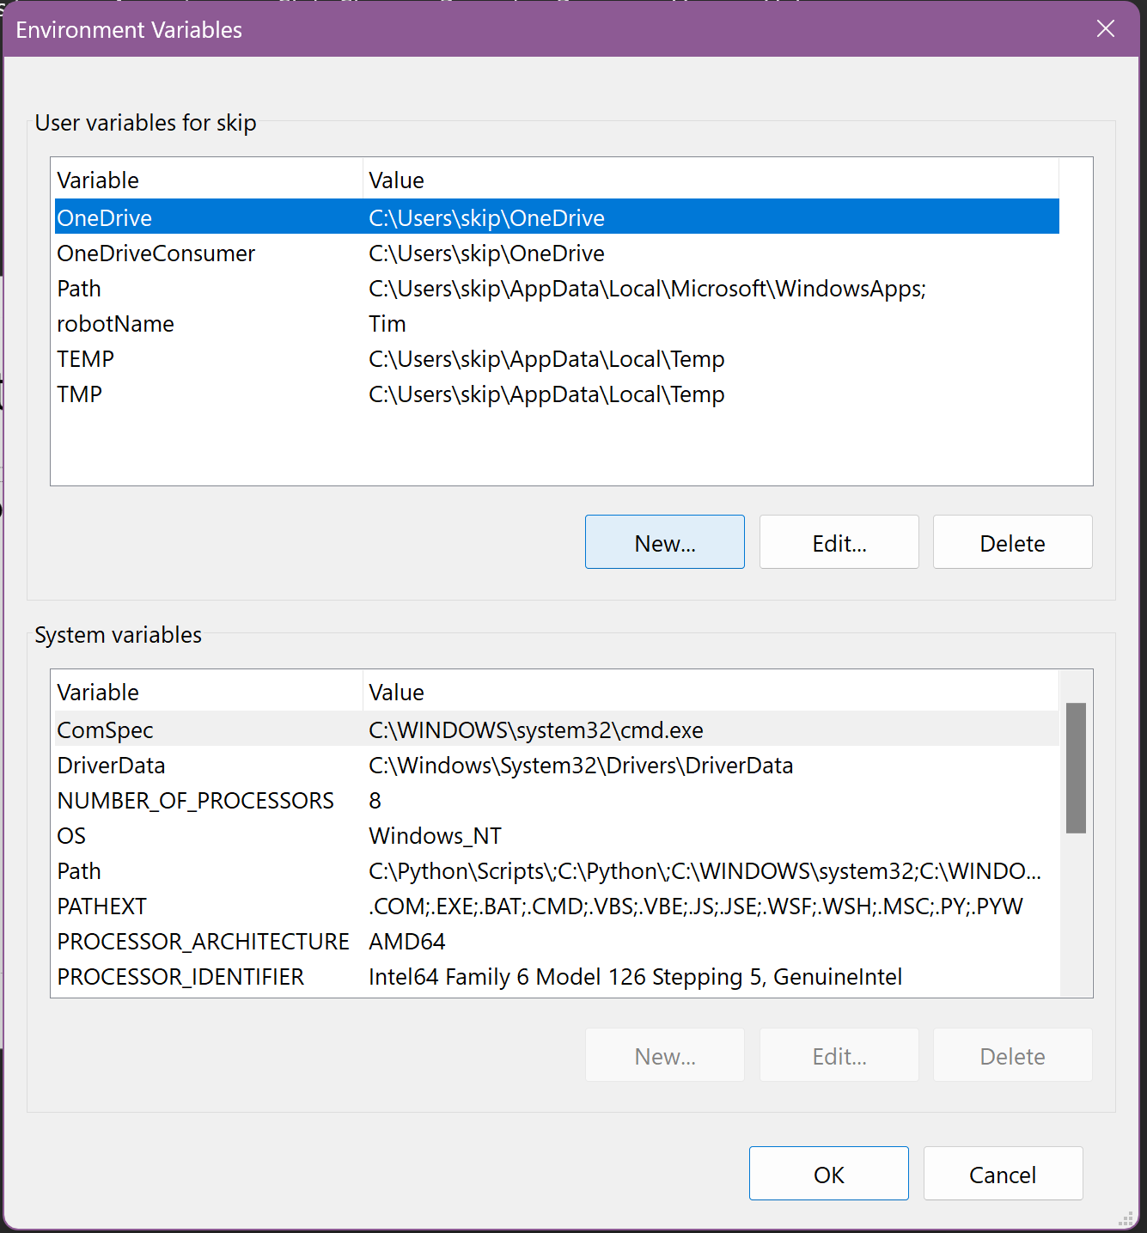
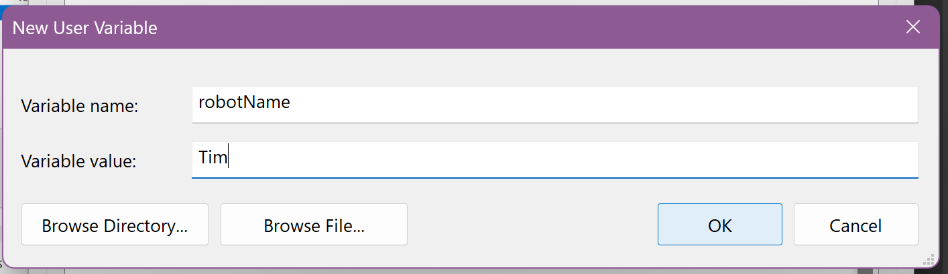
Enter “robotName”
Enter YOUR robot’s name

Slide 28
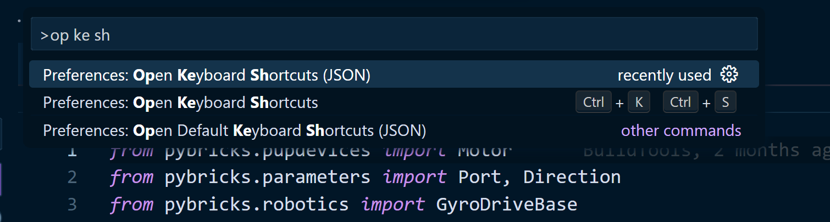
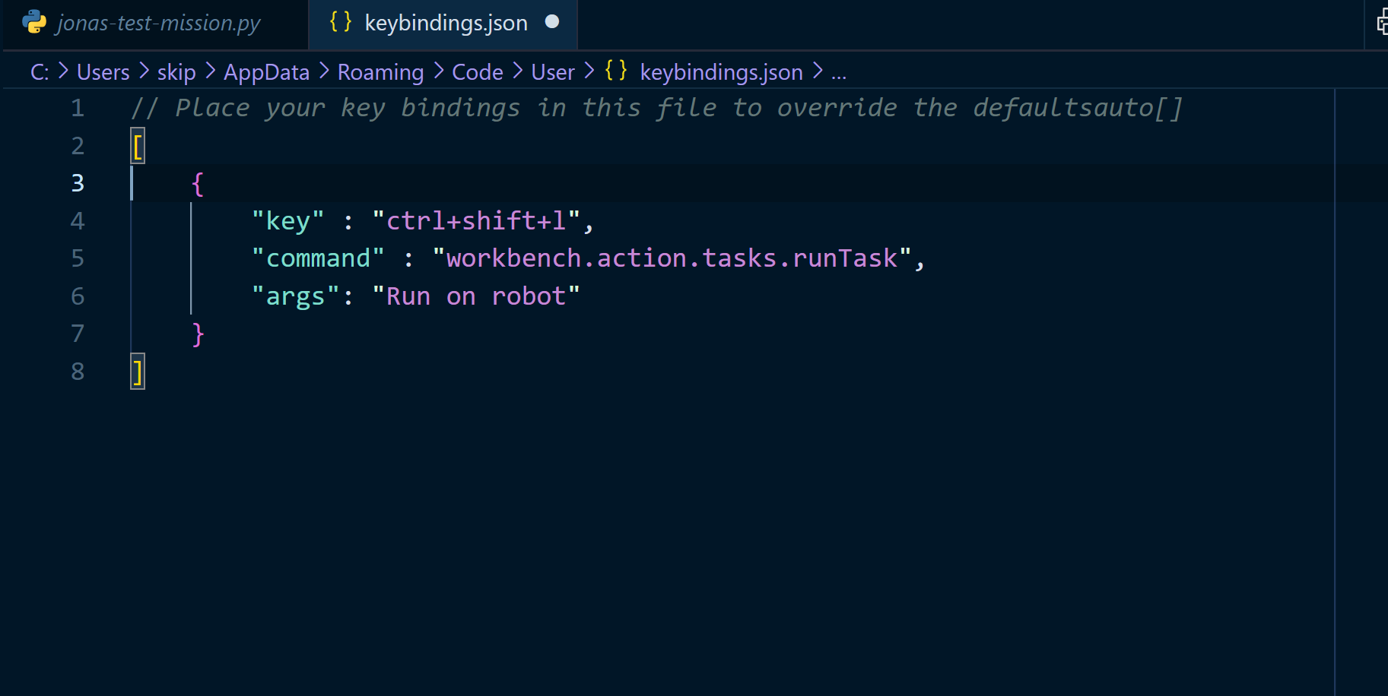
Step 12. Keyboard Shortcut
Last step, I promise! Add a keyboard shortcut to run the programs that we write. Ctrl-Shift-P > Preferences: Open Keyboard Shortcuts (JSON).
Pro-tip: type Ctrl-Shift-P, then type “op ke sh”.
Make sure you choose the entry that says “JSON” at the end
Edit the JSON to add the keyboard shortcut to run the task. Paste in the code from the team repo at the bottom of keybindings.json.

Slide 29
Step 13.
RUN OUR PROGRAM!
Turn the robot on and ensure the keyboard shortcut ctrl-shift-L runs the command, which should also run their program
Also, Ctrl-Shift-P > Tasks: Run task should pop up a menu with the correct entry
Watch the terminal and make sure the robot name is correct. If not, recheck that you completed step 11 correctly.

